Slide 1


Housing Affordability and Telecommunication Expansion
Ruben Brionez Jr
06-29-2025

Slide 2
Introduction & Business Problem
The problem being addressed is the process for evaluating new markets for our startup telecommunication company.
The goal is to identify new markets for our fiber internet expansion
The focus for new markets:
Ohio
Michigan
Pennsylvania

Slide 3

Data Sources
Data sources used for the analysis include:
U.S. Census data for median income.
Zillow public data sets for home prices and required income to meet the standard 20% down.
CSVs of the data sets were processed using pandas and Jupyter Notebook.

Slide 4

Affordability Ratio
The affordability ratio used is defined as:
Income needed (for 20%) / home price.
Affordability ratio was the key metric used for the analysis.

Slide 5

Modeling Approach for Analysis
Initially a logistic regression modal was used to attempt to predict the future markets with affordable housing.
There was not a strong enough linear relationship between variables for the logistic regression model to accurately predict.
A random forest model approach was attempted and the accuracy returned was 88% on the training data.

Slide 6
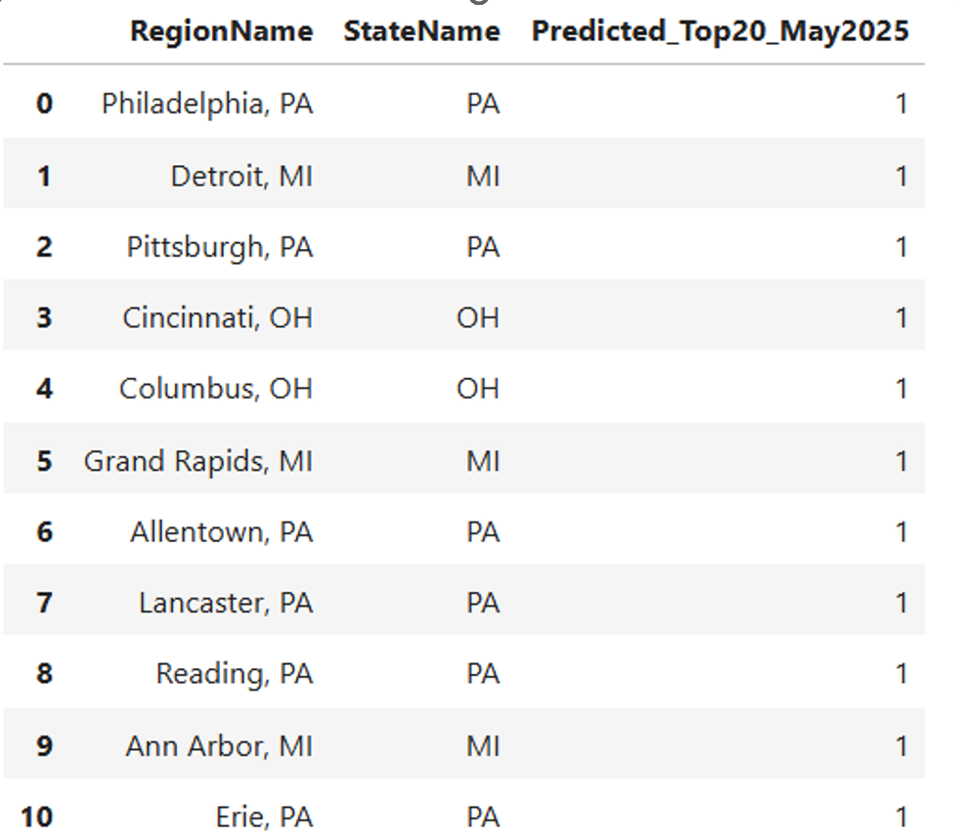
Key Findings
The random forest model has predicted these potential markets to remain or enter the top 20 list of affordable housing markets for the selected states.
These markets should now be further evaluated by business development for the various requirements their department requires.

Slide 7
Limitations and Assumptions
The income data is slightly outdated since it comes from the 2023 census. This was the most readily available income data available.
Race income data was combined to avoid bias.
The analysis did not incorporate direct population growth data or existing fiber infrastructure.

Slide 8
Q & A
Question
Answer
Could using metro-level income data (instead of state-level) improve the accuracy of the affordability analysis?
Using metro-level income data could absolutely improve the accuracy of the affordability analysis. However, during the initial analysis this data was not readily available.

Slide 9
Q & A
Question
Answer
What additional data sources (e.g., broadband adoption rates, population growth) could improve future versions of the model?
Population growth data and existing broadband infrastructure would be great additional data to have that would improve the model and yield more actionable results.

